Slide 1



Research Data Curation & Preservation
Lillian Mwango

Slide 2
Take away
What is data curation and preservation?
Why curate and preserve data?
How to curate and preserve your data?
Where to preserve and archive your data?

Slide 3
The old way of doing research (Science)
1. Researcher collects data (information)
2. Researcher interprets /synthesizes data
3. Researcher writes paper based on data
4. Paper is published (and preserved)
5. End of research project
6. ???
Martin Donelly – Digital Data Curation at the Digital Curation Centre(DH2016)

Slide 4
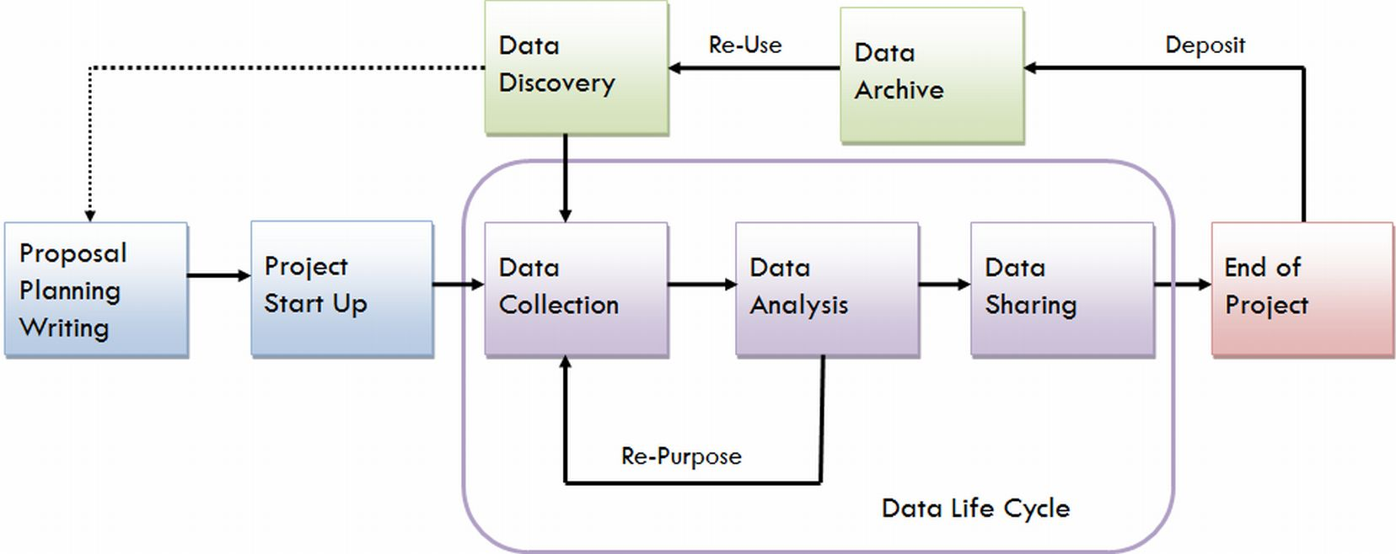
Research in the current age
https://data.library.virginia.edu/data-management/lifecycle/
Notes:
The scholarly record is evolving to incorporate a broader range of research outputs, moving beyond traditional publications like journal articles and monographs. Research data is a salient and well-documented example of this shift

Slide 5
1.What is data curation & preservation?

Slide 6
Data Curation
“… involves maintaining, preserving and adding value to digital research data throughout its lifecycle.
The active management of research data reduces threats to their long-term research value and mitigates the risk of digital obsolescence.”
~Digital Curation Centre, UK
Notes:
In other words, so that we and others can re-use data in the future
Data curation activities enable data discovery and retrieval, maintain data quality, add value, and provide for re-use over time.
Data curation is the process by which data are put into a state to be managed so that they can be understood and used by parties across disciplines and organizations. The passage of time should not prohibit the use of the data. This requires that appropriate measures be undertaken to ensure data infrastructure, searchability, availability, and preservation.

Slide 7
Data Preservation
“… actions to ensure long-term preservation and retention of the authoritative nature of data.
Preservation actions should ensure that data remains authentic, reliable and usable while maintaining its integrity. Actions include data cleaning, validation, assigning preservation metadata, assigning representation information and ensuring acceptable data structures or file formats”
~ Digital Curation Centre, UK

Slide 8

Storage: storing raw copy of data such that it can be retrieved at a later date with 100% accuracy
Preservation: the active management of digital information over tome to ensure its accessibility
Curation: Maintaining, preserving and adding value to digital research data throughout its life cycle
https://www.kisspng.com/png-question-mark-icon-handsome-man-512327/preview.html
Notes:
Data storage is confined to simply keeping data in existence and ensuring that it can be accessed when needed. It does not necessarily entail practices of refreshment or format migration (essential to maintaining the data in a usable form) nor does it entail higher-level curatorial practices such as enhancement of the data through added metadata, or migration from one representational standard to another. Data curation thus goes far beyond the scope of data storage.
Data curation: defined as the active and on-going management of data through its lifecycle of interest and usefulness to scholarly and educational activities across the sciences, social sciences, and the humanities (Cragin et al. 2007). Maintaining, preserving and adding value to digital research data throughout its life cycle. Data curation activities enable data discovery and retrieval, maintain data quality, add value, and provide for re-use over time.
Digital Preservation: the series of actions and interventions required to ensure continued and reliable access to authentic digital objects for as long as they are deemed to be of value

Slide 9
2. Why Curate and preserve?

Slide 10
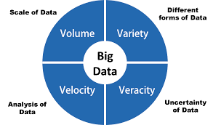
The data deluge
Volume of data being generated is overwhelming the capacity of institutions to manage it and researchers to re-use it
Notes:
Vast quantities of born-digital research data are now being produced in a wide variety of forms and at a rapid rate in universities, creating the so-called “volume”, “variety” and “velocity” challenges of data [1], [2].

Slide 11
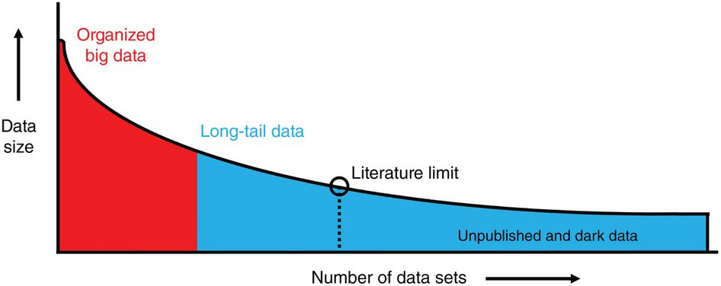
Dark data is hard to find and inaccessible
Dark data ≠ published or made available
Less well planned
Poorly curated
Less visible/inaccessible to other scientist
Heidorn, P. Brian(2018). &
Ferguson, Adam R., et al. (2014).
Notes:
Dark data is information or results from research that has never been published or made available to the rest of the research community
Poorly curated - lacks adequate documentation/metadata Sits on quickly aging devices
Heidorn, P. Brian(2018). Shedding light on the Dark Data in the Long tail of Science. Library Trends 57(2) Fall 2008
&
Ferguson, Adam R., et al. "Big data from small data: data-sharing in the 'long tail’ of neuroscience." Nature neuroscience 17.11 (2014): 1442.

Slide 12
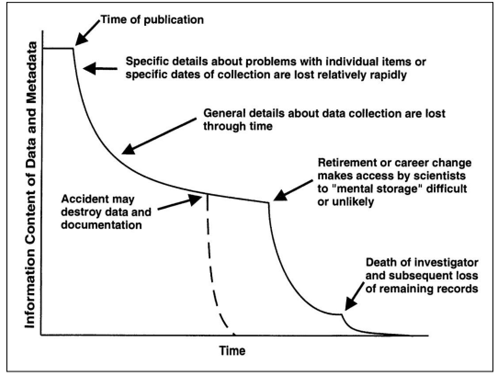
Data Entropy
Data lost through:
Degradation of raw data or metadata
Deterioration/Obsolescence/damage of storage media or analytical equipment
Discrete events: career changes, retirement, death
Neglect or loss of data forms & notes
Researchers memory attrition
(Michener et al. 1997; Michener 2007)
Notes:
Not all data collected in research ends up in publications especially finer details
The major cause of the reduced data availability for older papers was the rapid increase in the proportion of data sets reported as either lost or on inaccessible storage media. For papers where authors reported the status of their data, the odds of the data being extant decreased by 17% per year (Figure 1D).
Rate of loss increases after project results have been published or the study has been terminated
Specific details are usually lost firs

Slide 13
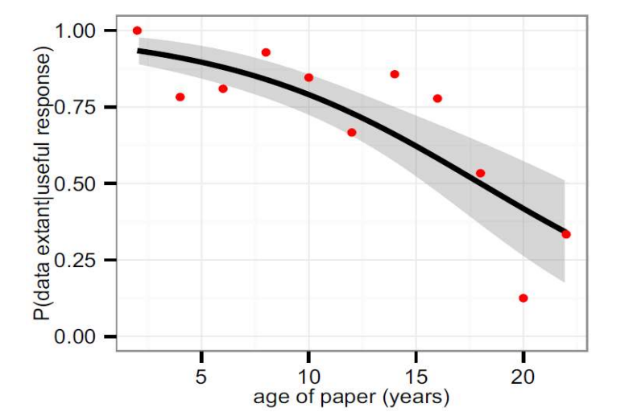
Availability of Research Data vs Article Age
80% data unavailable after 20 years
Data reported as either:
lost or
on inaccessible storage media
Vines et al., Current Biology(2014), http://dx.doi.org/10.1016/j.cub.2013.11.014
Notes:
The major cause of the reduced data availability for older papers was the rapid increase in the proportion of data sets reported as either lost or on inaccessible storage media. For papers where authors reported the status of their data, the odds of the data being extant decreased by 17% per year (Figure 1D).
Vines et al., The Availability of Research Data Declines Rapidly with Article Age, Current Biology
(2014), http://dx.doi.org/10.1016/j.cub.2013.11.014

Slide 14

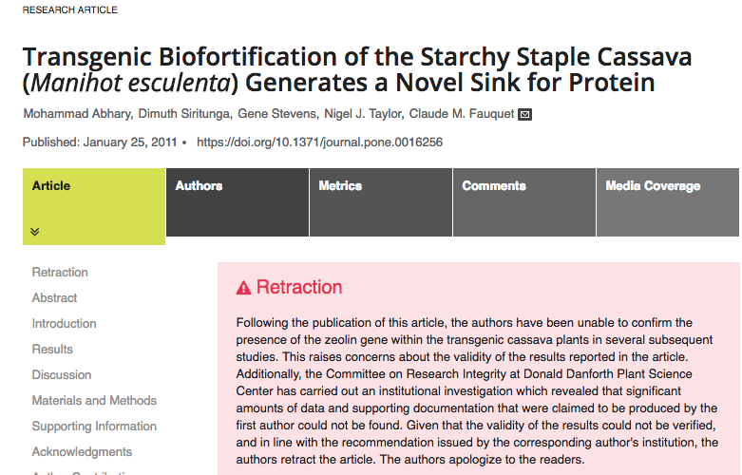
Research validation

Slide 15

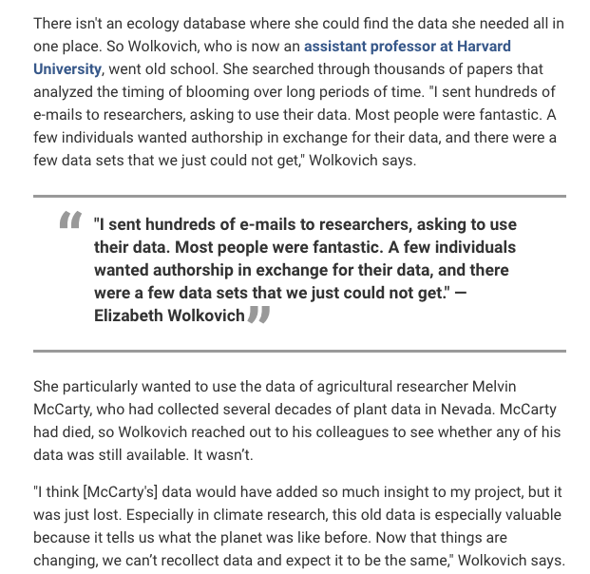
https://www.sciencemag.org/careers/2014/04/chasing-down-data-you-need

Slide 16
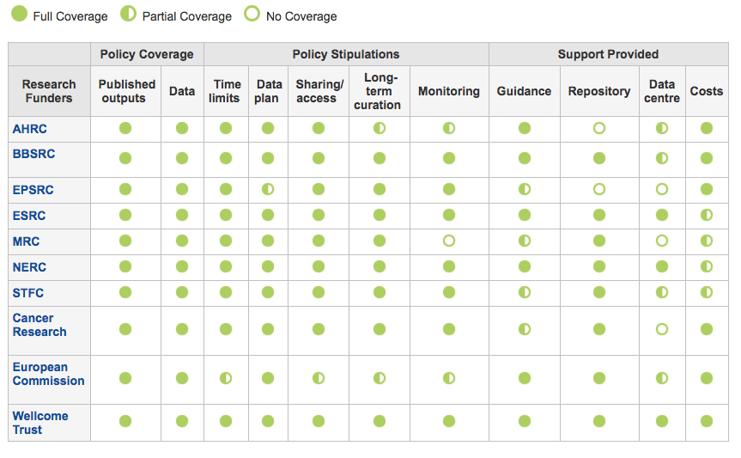
Funder Requirements
Publish appropriately structured metadata describing the research data they hold.
Ensure that EPSRC-funded data is securely preserved for a minimum of ten years.
Ensure that effective data curation is provided throughout the full data lifecycle.
Notes:
Increasingly a requirement by research funding bodies
research funding and performing bodies are taking an increasing interest in what happens to research data”. They want credit to assert ownership, want to know about impact and reuse, and are interested in connecting data and publications

Slide 17


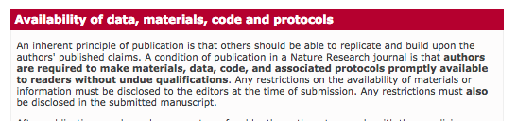

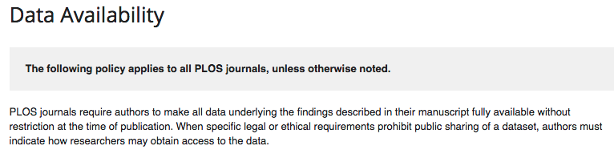

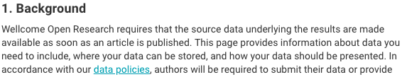
Journal/Publisher Data Policies
Vasilevsky NA, Minnier J, Haendel MA, Champieux RE. 2017. Reproducible and reusable research: are journal data sharing policies meeting the mark? PeerJ 5:e3208 https://doi.org/10.7717/peerj.3208

Slide 18
Exercise
What causes of data loss?
Outdated file format – WordPerfect file
Outdated storage media – floppy disc
Required software is not available or supported
The computer running the software is not available
The file or drive is corrupt
Insufficient documentation
No preservation and archiving plan
Notes:
Benign neglect- results from not having an active strategy in place for long-term preservation. Without an active preservation strategy, there are no guarantees that your data will be usable years later, or when others need it.
Bit rot- Digital data are represented as bits, or units of machine-readable information. These bits may degrade or become corrupted over time, which we refer to as bit rot. This perceived rot may cause decreased, delayed, or faulty rendering of the data.
obsolescence - In addition, the physical media on which the data are stored, may also gradually decay.
insufficient documentation- A lack of complete and appropriate documentation and metadata can make it impossible to interpret the data in the future.

Slide 19
Summary
Curation & preservation is integral parts of research data management life cycle.
Curation & preservation activities:
Add Value
Promote research Longevity
facilitate long-term access, discoverability and re-use

Slide 20
3. When / How to curate & preserve your data

Slide 21
Approaches
Post hoc curation
curation after all of the data have been collected and analyzed
hugely time-consuming and cumbersome to the data contributor
Active curation
curate immediately following each data collection—to organize, describe, and store the data at an early phase of the research life cycle
Notes:
Post hoc curation - curation after all of the data have been collected and analyzed. is the most common way that researchers contribute data to domain repositories. However, post hoc curation is hugely time-consuming and cumbersome to the data contributor. To prepare the data for deposit, researchers must revisit data that they have already collected, analyzed, and stored away and now organize and describe it for the purpose of sharing.
Active curation - curate immediately following each data collection—to organize, describe, and store the data at an early phase of the research life cycle, rather than as a burdensome final step at the end of the project

Slide 22
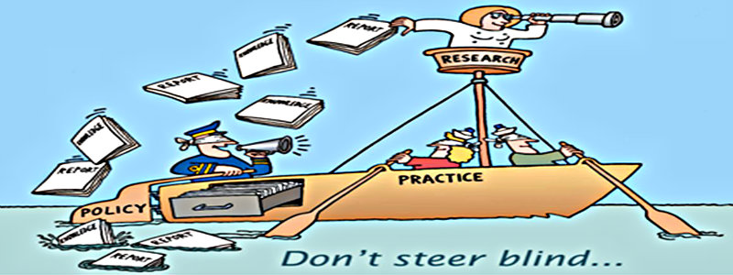
Conceptualize
Define your mission
Develop policies and procedure
Identify your target audience
Have a budget
Draw a staffing model
Develop or acquire the technological infrastructure
https://www.cecan.ac.uk/sites/default/files/inline-images/dont%20steer%20blind.jpg

Slide 23
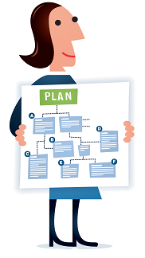
Review Data Management Plan
Which data should be preserved?
For how long will the data be preserved?
Who is responsible for preserving the data?
How and Where will the data be hosted and accessed
saving data on hard drives/servers/etc. is not data preservation - it's data storage
https://www.dpconline.org/images/planning.png
Notes:
Data preservation involves data curation activities such data integrity checks, format migrations, and the creation of descriptive records
Which data have long-term value?
Examples: data that cannot easily be recreated or produced; data that is costly to reproduce; data of one-time events; experimental data; etc.
Which data are you required to keep?
Data which are necessary to validate research findings. (Please see the Requirements by Funding Agency section for more details).

Slide 24
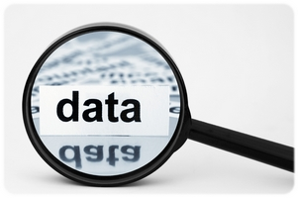
Check files and read documentation
Review the content of the data files (e.g., open and run the files or code).
Verify all metadata provided and review the available documentation.
Data Curation Network (2018). “Checklist of CURATED Steps Performed by the Data Curation Network.” htttp://datacurationnetwork.org.
Notes:
Check files and read documentation (risk mitigation, file inventory, appraisal/selection)
Is the data unchanged?
Can data still be read and used?
Is the metadata still there/sufficient?
Are the formats still usable?
Is the software still available?
Can programs still be run?
Is data still in the right place?
What does your DMP say? What has changed?

Slide 25
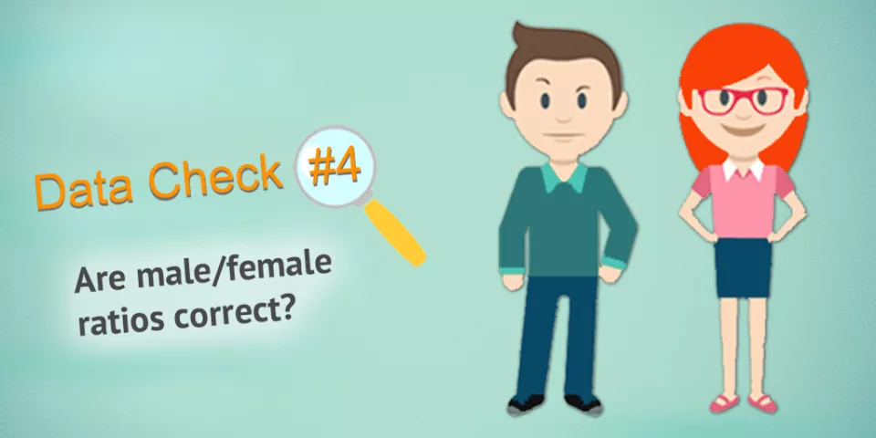
Understand the data
Check for quality assurance and usability issues such as missing data
Try to detect and extract any “hidden documentation”
Determine if the documentation of the data is sufficient
https://www.humanitariandatasolutions.com/8-ways-to-check-your-data-quality/
Notes:
Check for quality assurance and usability issues such as missing data, ambiguous headings, code execution failures, and data presentation concerns.
Try to detect and extract any “hidden documentation” inherent to the data files that may facilitate reuse.
Determine if the documentation of the data is sufficient for a user with similar qualifications to the author’s to understand and reuse the data. If not, recommend or create additional documentation (e.g., a readme.txt template).

Slide 26
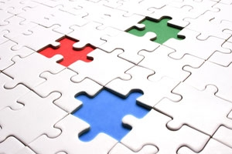
Request missing information
Generate a list of questions for the data author to fix any errors or issues
describe concerns, issues, and needed improvements to the data
https://www.universiteitleiden.nl/binaries/content/gallery/ul2/main-images/social-and-behavioural-sciences/labfaciliteiten/missing-data.jpg/missing-data.jpg/d300xvar

Slide 27
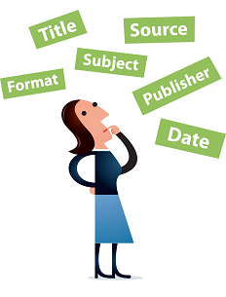
Augment the submission
Enhance metadata to best facilitate discoverability.
Create and apply metadata for the data record
When appropriate, structure and present metadata in domain-specific schemas to facilitate interoperability with other systems.
https://www.dpconline.org/images/metadata.png

Slide 28
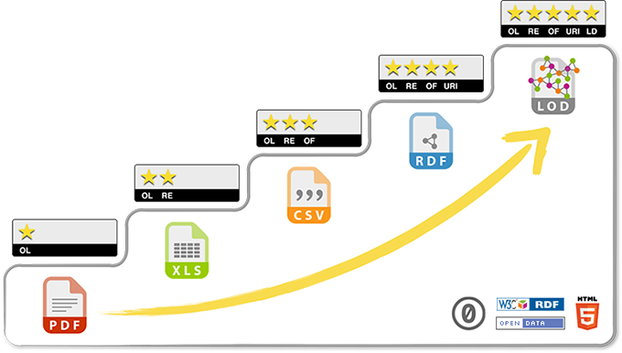
Transform file formats
Identify specialized file formats and their restrictions
(e.g., Is the software freely available? Link to it or archive it alongside the data).
Transform files into open, non-proprietary file formats
Note: Retain original files if data transfer is not perfect
https://5stardata.info/en/
Notes:
Identify specialized file formats and their restrictions (e.g., Is the software freely available? Link to it or archive it alongside the data).
Transform files into open, non-proprietary file formats that broaden the potential audience for reuse and ensure that preservation actions might be taken by the repository in later steps.
Retain original files
Reference: List of preservation formats. http://guides.library.cornell.edu/ecommons/formats
Recommenrations:
complete and open documentation
platform-independence
non-proprietary (vendor-independent)
no "lossy" or proprietary compression
no embedded files, programs or scripts
no full or partial encryption
no password protection

Slide 29
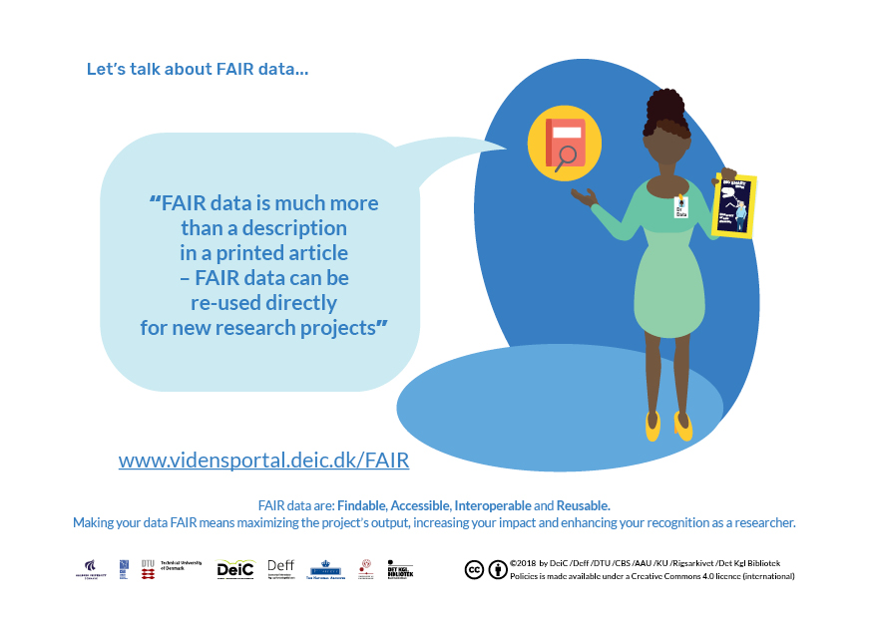
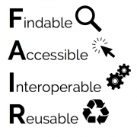
Evaluate and rate FAIRness
Score the dataset and recommend ways to increase the FAIRness of the data
https://vidensportal.deic.dk/en/FAIR

Slide 30

Document curation activities
Record all necessary information capturing who did what to the dataset and when
https://png.pngtree.com/svg/20160721/5d2eac559c.svg
Notes:
Data Curation Network (2018). “Checklist of CURATED Steps Performed by the Data Curation Network.” htttp://datacurationnetwork.org.

Slide 31
Exercise
How would you rate the “importance” of a variety of key data curation activities

Slide 32
4. Protecting confidentiality

Slide 33
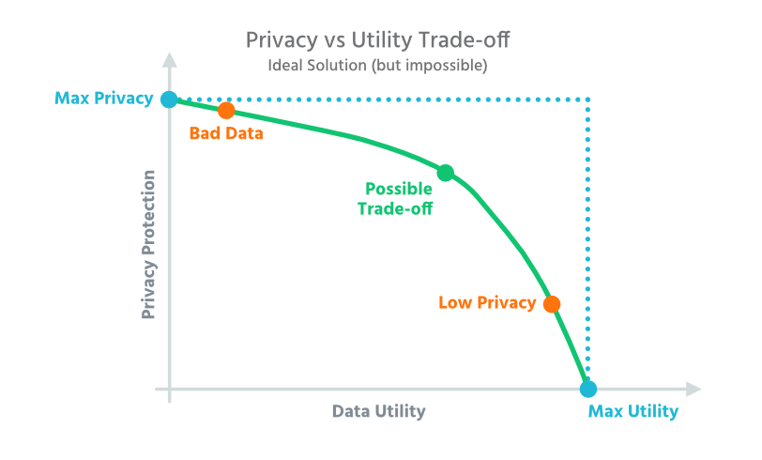
Anonymising / De-identifying data
The process of removing identifying information so that the remaining data does not make it possible identify an entity
It’s a balance between utility
and privacy
Depends on:
type of data
sensitivity of data
type of release
risk based approach

Slide 34
Why we anonymise data?
Ethical reasons
protect people’s identity (sensitive, illegal, confidential information)
disguise research location
Legal reasons
not to disclose personal data
Commercial reasons

Slide 35
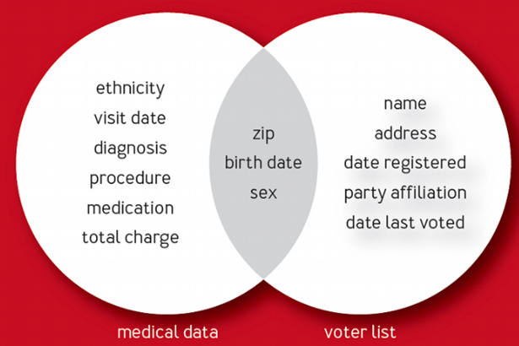
Disclosure risks
How much information do you need to identify someone?
Identity disclosure (re-identification)
Attribute disclosure
Inference disclosure
Notes:
Identity disclosure or re-identification, which may take place as the result of
insufficient de-identification, or by linking the data to another source and this way
disclosing the identity
Attribute disclosure – the attacker can infer attribute information of an individual
(e.g. the attacker may be able to infer with probability that a person has a certain
disease); this may also concern a group of people, if they are described with very
specific demographic data, and the group has a high rate of a negative feature.
Natarajan & al. (2012) call this collective privacy. e.g.
E.g. a dataset containing
anonymised client records of a particular aesthetic surgeon reveals that all his clients below the age of 30 have
undergone a particular procedure. If it is known that a particular individual is 28 years
old and is a client of this surgeon, we then know that this individual has undergone
the particular procedure, even if the individual’s record cannot be distinguished from
others in the anonymised dataset.
Membership disclose – the attacker can infer that an individual’s data is likely to be
included in a published dataset.
infer about an individual even if he/she is not in the dataset, by statistical properties of the dataset.
E.g. if a dataset released by a medical researcher reveals that 70% of individual aged
above the age of 75 have a certain medical condition, this information could be
inferred on an individual who is not even in the dataset.

Slide 36
Techniques
Attribute suppression
Removal of an entire part of data (also referred to as “column” in databases and spreadsheets) in a dataset
When to use it: When an attribute is not required in the anonymised dataset, or when the attribute cannot otherwise be suitably anonymised with another technique. This technique should be applied at the start of the anonymisation process, as it is an easy way to decrease identifiability at this point.
Notes:
When to use it: When an attribute is not required in the anonymised dataset, or when the attribute cannot otherwise be suitably anonymised with another technique. This technique should be applied at the start of the anonymisation process, as it is an easy way to decrease identifiability at this point.

Slide 37
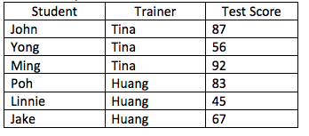
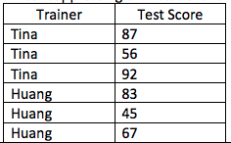
Example
In this example, the dataset consists of test scores. As the recipient only needs to analyse test scores obtained by students with respect to their various trainers but without analysis on the students themselves, the “student” attribute was removed.
Before
After

Slide 38
Techniques
Record Suppression
Record suppression refers to the removal of an entire record in a dataset. In contrast to most other techniques, this technique affects multiple attributes at the same time.
When to use it: To remove outlier records which are unique or do not meet other criteria such as k-anonymity, and not to keep in the anonymised dataset. Outliers can lead to easy re-identification. It can be applied before or after other techniques (e.g. generalisation) have been applied.
Notes:
When to use it: To remove outlier records which are unique or do not meet other criteria such as k-anonymity, and not to keep in the anonymised dataset. Outliers can lead to easy re-identification. It can be applied before or after other techniques (e.g. generalisation) have been applied.

Slide 39
Example
Firstname | Lastname | Ageyears
Xing | Chan | 101

Slide 40
Techniques
Character Masking
Character masking is the change of the characters of a data value, e.g. by using a constant symbol (e.g. “*” or “x”). Masking is typically partial, i.e. applied only to some characters in the attribute.
When to use it: When the data value is a string of characters and hiding part of it is sufficient to provide the extent of anonymity required.
Notes:
When to use it: When the data value is a string of characters and hiding part of it is sufficient to provide the extent of anonymity required.

Slide 41
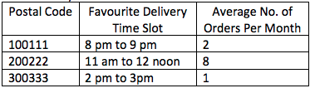
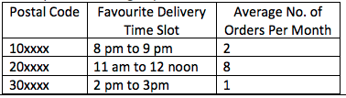
Example
This example shows an online grocery store conducting a study of its delivery demand from historical data, in order to improve operational efficiency. The company masked out the last 4 digits of the postal codes, leaving the first 2 digits, which correspond to the “sector code” within Singapore.
Before
After

Slide 42
Technique
Pseudonymisation/Coding
The replacement of identifying data with made up values. Pseudonyms can be irreversible, or reversible (by the owner of the original data), where the original values are securely kept but can be retrieved and linked back to the pseudonym, should the need arises
When to use it: When data values need to be uniquely distinguished and where no character or any other implied information of the original attribute shall be kept.
Notes:
When to use it: When data values need to be uniquely distinguished and where no character or any other implied information of the original attribute shall be kept.

Slide 43
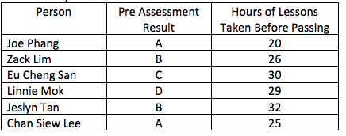
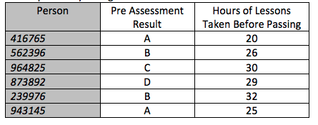
Example
This example shows pseudonymisation being applied to the names of persons who obtained their driving licenses, and some information about them. In this example, the names were replaced with pseudonyms instead of the attribute being suppressed, because the organisation wanted to be able to reverse the pseudonymisation if necessary
Before
After

Slide 44
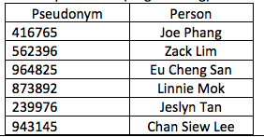
Example
For reversible pseudonymisation, the identity database is securely kept in case there is a future legitimate need to identify individuals. Security controls (including administrative and technical ones) should also be used to protect the identity database.

Slide 45
Techniques
Generalisation
Description: a deliberate reduction in the precision of data. E.g. converting a person’s age into an age range, or a precise location into a less precise location. This technique is also referred to as recoding.
When to use it: for values that can be generalised and still be useful for the intended purpose.
Notes:
When to use it: for values that can be generalised and still be useful for the intended purpose.

Slide 46
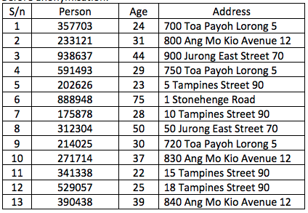
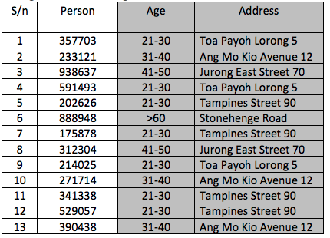
Example
In this example, this dataset contains person name (which has already been pseudonymised), age in years, and residential address.
Before
After

Slide 47
Techniques
Swapping
The purpose of swapping is to rearrange data in the dataset such that the individual attribute values are still represented in the dataset, but generally, do not correspond to the original records. Also referred to as shuffling and permutation.
When to use it: when subsequent analysis only needs to look at aggregated data, or analysis is at the intra-attribute level; in other words, there is no need for analysis of relationships between attributes at the record level.
Notes:
When to use it: when subsequent analysis only needs to look at aggregated data, or analysis is at the intra-attribute level; in other words, there is no need for analysis of relationships between attributes at the record level.

Slide 48
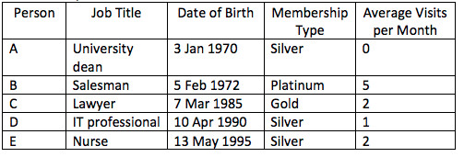
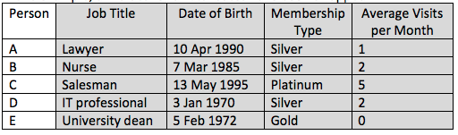
Example
In this example, the dataset contains information about customer records for a business organisation.
Before
After
Notes:
Note: On the other hand, if the purpose of the anonymised dataset is to study the relationships between job profile and consumption patterns, other methods of anonymisation may be more suitable, e.g. via generalisation of job titles, which could result in “university dean” being modified to become “educator”.

Slide 49
Techniques
Data Aggregation
converting a dataset from a list of records to summarised values.
When to use it: when individual records are not required and aggregated data is sufficient for the purpose.
Notes:
When to use it: when individual records are not required and aggregated data is sufficient for the purpose.

Slide 50
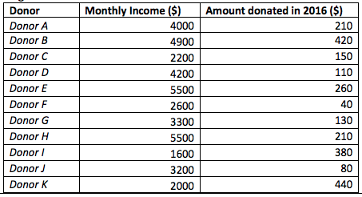
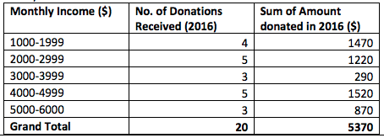
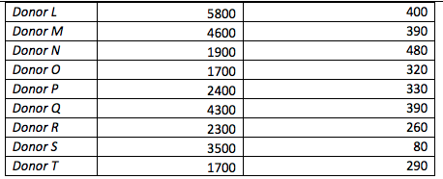
Example
In this example, a charity organisation has records of the donations made, as well as some information about the donors. The charity organisation assessed that aggregated data is sufficient for an external consultant to perform data analysis, hence performs data aggregation on the original dataset.
After

Slide 51
Other Techniques
Data perturbation
Hashing
Synthetic data

Slide 52
Selecting methodology
Determine the release model
Determine acceptable re-idetification risk threshold
Classify data attributes
Consider technical controls
restricted access, query only, limit recipients, Digital Rights Management, on-site-access
Encryption Keys and Mapping tables need to properly managed and secured

Slide 53
Techniques
Data Perturbation
the values from the original dataset are modified to be slightly different.
When to use it: for quasi-identifiers (typically numbers and dates) which may potentially be identifying when combined with other data sources, and slight changes in value are acceptable. This technique should not be used where data accuracy is crucial.
Notes:
When to use it: for quasi-identifiers (typically numbers and dates) which may potentially be identifying when combined with other data sources, and slight changes in value are acceptable. This technique should not be used where data accuracy is crucial.

Slide 54
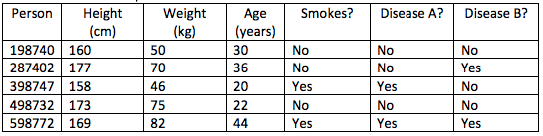
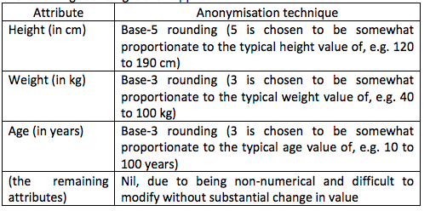
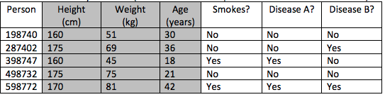
Example
In this example, the dataset contains information to be used for research on possible linkage between a person’s height, weight, age, whether the person smokes, and whether the person has “disease A” and/or “disease B”. The person’s name has already been pseudonymised.
After

Slide 55
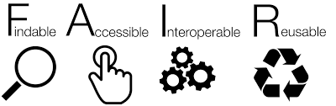
5. Where to preserve and archive

Slide 56

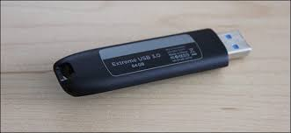
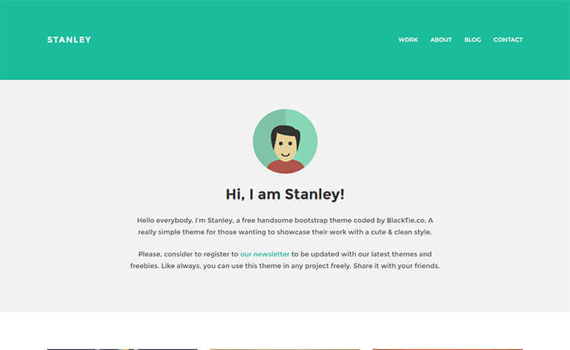
Where not to preserve your data
Probably no:
persistent identifiers, access
No data citation mechanism
provision for future preservation
professional backup
metadata/interoperability
You will waste time:
Managing access requests
preserving data for reuse

Slide 57
Journal supplementary materials
Advantages
Most likely to comply with the journal or publisher’s requirements;
Data readily available alongside published findings.
Disadvantages
May be costly;
May claim copyright over the data;
May keep data behind a subscription wall;
Unlikely to offer a data repository’s functionality or long-term solution;
May not apply user-friendly or preservation formats;
More likely to accept subsets rather than complete datasets

Slide 58
Data repositories
online database service, an archive that manages the long-term storage and preservation of digital resources and provides a catalogue for discovery and access
maybe specialized and relegated to aggregating disciplinary data or more general, collecting over larger knowledge areas, such as the sciences or social sciences

Slide 59
Institutional (Local) Data repository
Advantages
Most likely to accept any data of value, especially if no suitable home can be found for it elsewhere, and to ensure that policy requirements for long-term access are met;
Researchers may trust such a repository more readily;
Possibly no charge for the data deposit;
May make your data visible via dissemination and promotion.
Disadvantages
May not offer sustainable long-term access to your data collection;
Might not have sufficient expertise in data and metadata standards needed for long time preservation and access.

Slide 60





Online Domain Data repositories
Advantages
Offers specialist domain knowledge and data management expertise, e.g. to create a catalogue record and documentation;
Likely to accept complete datasets (and not only the part of the dataset on which a publication is based);
May make your data visible via dissemination and promotion.
Disadvantages
Likely to be selective about what kind of data they accept.

Slide 61



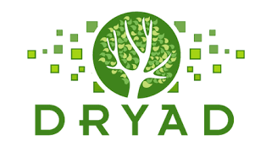

General Data Repositories
Advantages
Most likely to offer useful search, navigation and visualisation functionality;
Reach a wider audience of potential users;
Accepts a wide range of data types;
Suitable for cross-disciplinary data.
Advantages
Requires scrutiny of terms and conditions to ensure consistency with your funder, journal or institution’s policies on cost recovery, copyright/IP, and long-term preservation;
No editorial control over quality of deposited materials;
In most cases, only simple metadata is available, which is usually not enough for reuse.

Slide 62
Before selecting a data repository
Questions to consider:
Does your funder specify a specific location or facility?
Does your discipline recommend a specific repository?
Does your publisher require placement of data in support of an article in a specific location?
Does your institution have specific requirements/policy?

Slide 63
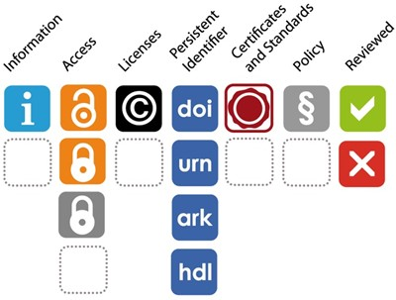
While selecting a data repository
Select a data repository that:
Matches your particular data needs
Gives your submitted dataset a persistent and unique identifier.
Provides Index/discovery tools
Gives you a variety of access terms
Policies and licenses
Track scholarly access and usage impact
Provides data citation
Matches your budget
Trustworthy (certification + standards)
Reviewed
Notes:
Gives your submitted dataset a persistent and unique identifier.
This is essential for sustainable citations – both for data and publications – and to make sure that research outputs in disparate repositories can be linked back to particular researchers and grants.
Provides Index/discovery tools
How will others discover your dataset?
Is the repository indexed by Google and/or scholarly databases in your field?
Provides a landing page for each dataset, with metadata that helps others find it, tell what it is, relate it to publications, and cite it. This makes your research more visible and stimulates reuse of the data.
Track scholarly access and usage impact
Helps you to track how the data has been used by providing access and download statistics.
Policies and licenses
Data user agreements and licensing allow owners to state explicitly up front what uses they would be willing to allow.
Open, closed, or restricted access
Creative Commons licensing
Matches your particular data needs
(e.g. formats accepted; access, back-up and recovery, and sustainability of the service). Most of this information should be contained within the data repository’s policy pages.
Data citation
Provides guidance on how to cite the data that has been deposited.
Costs
Charges for its services.
Reviewed
Responds to community needs and is preferably certified as a ‘trustworthy data repository’, with an explicit ambition to keep the data available in the long term.

Slide 64
Licensing your data
Licensing allows you to specify what people can and cannot do with your data and allows both you and the users of your data to be clear on what the rights situation is in relation to your data.
Have an idea which license you plan to use before you start collecting the data.
Look in funder requirements & collaboration requirements
Notes:
Licensing allows you to specify what people can and cannot do with your data and allows both you and the users of your data to be clear on what the rights situation is in relation to your data.
It is best to have an idea which license you plan to use before you start collecting the data. This will allow you to clarify the legal position and ownership of the data early on and can help in planning consent requests from research participants.
If you are subject to funder requirements or collaborating with other researchers discuss your plans with them early on as well.

Slide 65
Available licenses
Creative Commons
licenses are a range of open licenses allowing you to mix and match the level of rights you are retaining and are commonly used for research publications and other research outputs
Open Data Commons
offer two licenses that are often used for research data

Slide 66
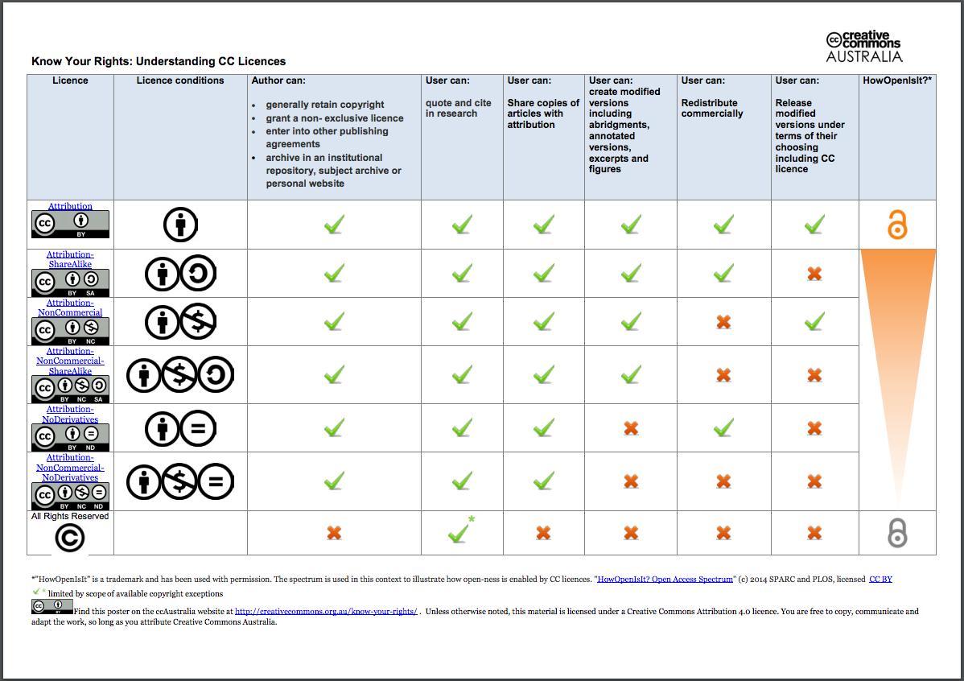
Creative Commons

Slide 67
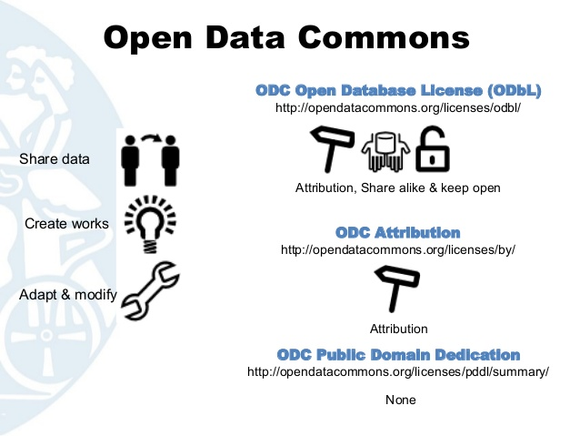
Open Data Commons
Notes:
ODC Public Domain and Dedication License (PDDL): This license is similar to the CC0 license in that it imposes no restrictions on the use of your data/database. Others are free to copy, distribute, and use your work; produce works from your data/database; and to modify, transform, and build upon the data/database.
ODC Attribution License: This license is similar to the CC BY license in that it allows others to copy, distribute, and use your work; produce works from your data/database; and to modify, transform, and build upon the data/database, as long as they provide you proper attribution.
Open Database License (ODbL): This license is similar to the CC BY-SA license in that it allows others to copy, distribute, and use your work; produce works from your data/database; and to modify, transform, and build upon the data/database, as long as they provide you proper attribution and any new works created are made available under this same license.
ODC also provides information on how these licenses differ from Creative Commons licenses in their application to databases.

Slide 68
Exercise: Publishing your data

Slide 69
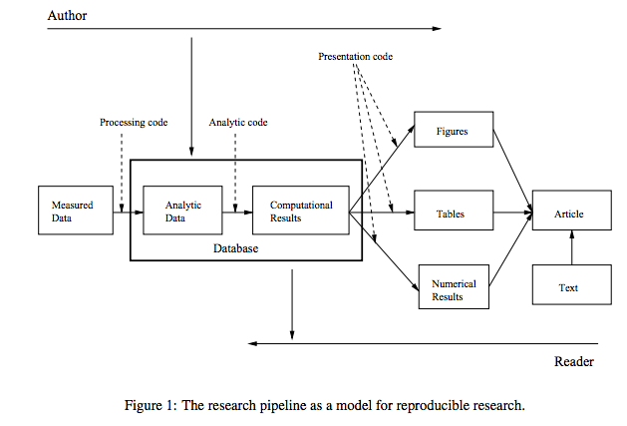
Code Review Exercise
Peng, R.D. and Eckel, S.P., 2008. Distributed reproducible research using cached computations. Computing in Science & Engineering, 11(1), pp.28-34.

